Slide 1

Big Data Analytics in Transportation Industry
BY : HARSHIT GAUR
NUID : 001093079
TO : PROF. RICHARD HE

Slide 2

shaving off JUST 1 mile per day FOR THEIR 66,000 driverS can result in savings of up to $50 million / year - UPS

Slide 3

ISSUES IN TRANSPORTATION INDUSTRY?
Shortage of Drivers & Operational Incapacity
Unoptimized routing
Unnecessary & Additional Financial Demands
Health & Safety
Technology

Slide 4
HOW BIG DATA ANALYTICS HELPS ?
Usage of sensory data in vehicles
Reduce fuel consumption
Optimize routing
Understands driving behavior
Inventory Management
Operational Capacity Planning
Allows optimal utilization and scaling of resources
Financial Demand and Supply Chain Analytics
Helps financial institutions improve their rating and investment decisions
Transparency in the Supply Chain process
Fewer errors in delivery & pickup
Real-time monitoring of the packages using sensors and GPS
Provides better shipping options

Slide 5

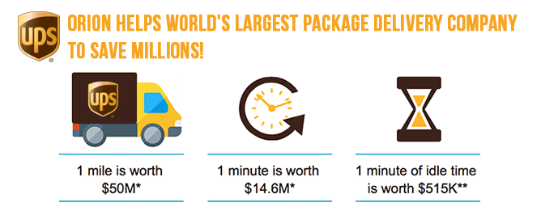

BIG DATA IN ACTION
On Road Integration Optimization and Navigation or ORION system built by UPS exclusively for its drivers.
This system maps the routes of each driver in the grid and details the entire route that the truck must take to help save precious miles, time, and money.

Slide 6
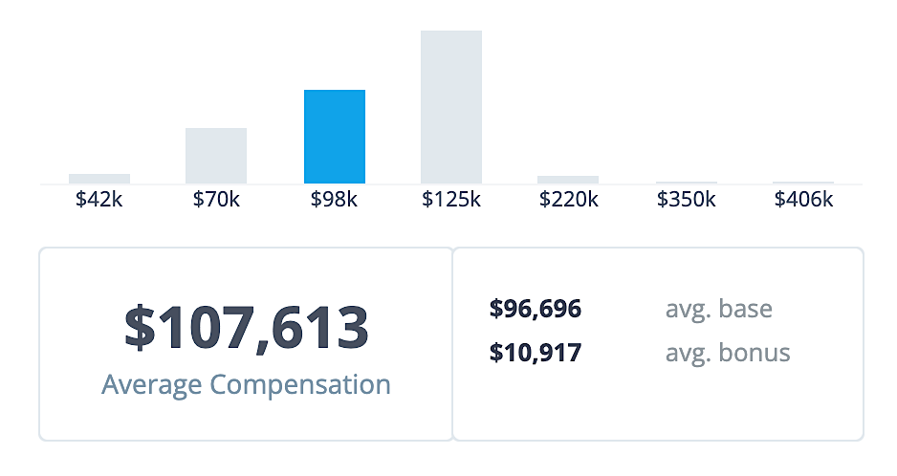
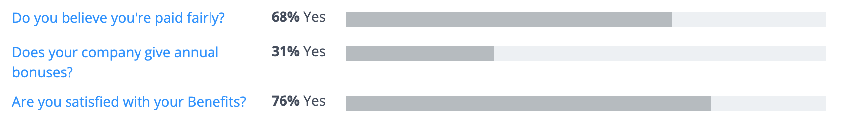
UPS - Data scientist
On average, a Data Scientist in transportation industry (UPS) earns :
about $96,000 as base salary
about $11,000 in bonuses
Source : https://www.comparably.com/companies/ups/salaries/data-scientist
Source : https://www.comparably.com/companies/ups/salaries/data-scientist

Slide 7
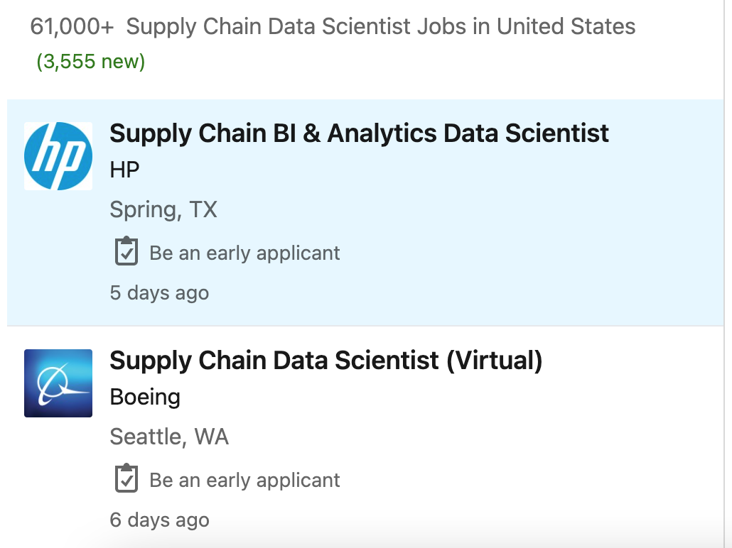
USA MARKET ANALYSIS
More than 61,000 jobs are currently posted for the role of Supply Chain Data Scientist in the USA.
Leading Companies
UPS
DHL
Amazon
Walmart
Target
TIBA Spain
NAEKO Logistics

Slide 8
internet of transportation - iotransport
Internet of Things (IoT) is revolutionising every aspect of life, and the transport sector is no exception.
Sensors, Traffic Lights, Cameras – all form part of Internet of Things (IoT) landscape

Slide 9
BIBLIOGRAPHY
W. (2021c, February 23). What Is the Impact of Big Data in the Transportation & Supply Chain Industries? 11 Possibilities with Big Data. GlobalTranz Enterprises, LLC. https://www.globaltranz.com/big-data-in-the-transportation/
Robins, C. (2015, March 16). Why Big Data is so Important to the Transportation Industry. Robins Consulting. https://www.robinsconsulting.com/why-big-data-is-so-important/
Feliu, C. (2021). 4 relevant Big Data case studies in Logistics. Big Data Case Studies in Logistics. https://blog.datumize.com/4-relevant-big-data-case-studies-in-logistics
Shatzkamer, K. (2021, October 6). Living On The Edge: How Next-Gen Mobile Networks Will Drive The Evolution Of Cloud Computing. Forbes. https://www.forbes.com/sites/googlecloud/2021/10/06/living-on-the-edge-how-next-gen-mobile-networks-will-drive-the-evolution-of-cloud-computing/?sh=18181ad530d8
UPS. (2021, October 27). UPS Data Scientist Salary. Comparably. https://www.comparably.com/companies/ups/salaries/data-scientist
75,000+ Supply Chain Data Scientist jobs in United States (4,224 new). (2021, October 23). LinkedIn. https://www.linkedin.com/jobs/search?keywords=Supply%20Chain%20Data%20Scientist&location=United%20States&geoId=103644278&trk=public_jobs_jobs-search-bar_search-submit&position=1&pageNum=0

Slide 10
Thank You

